Slide 1
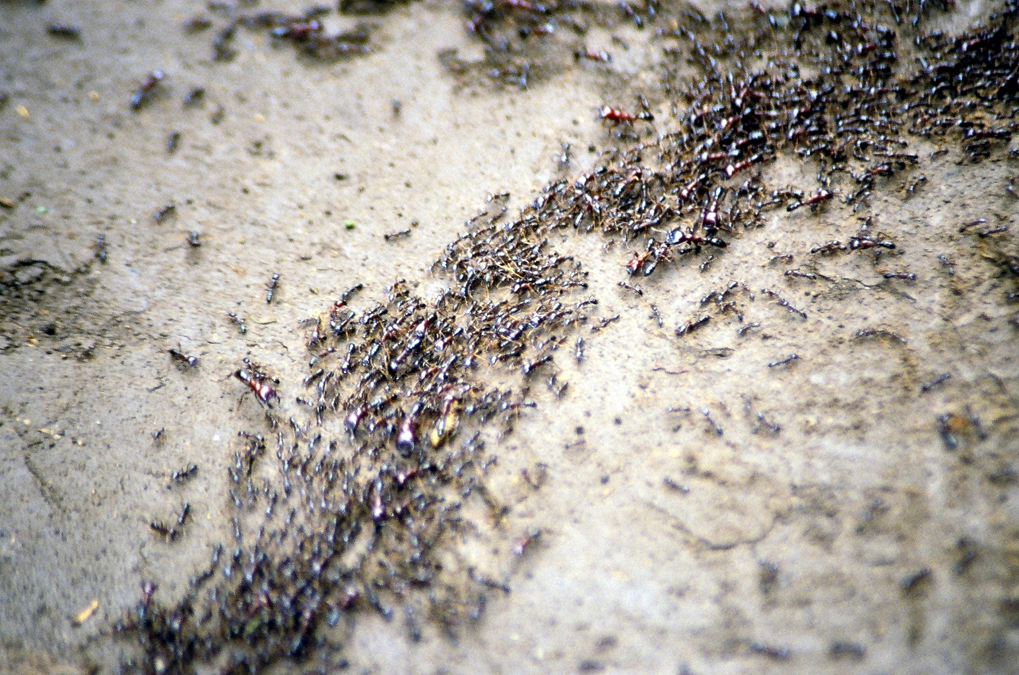
Ant Colony Optimisation
Group 5:
John Corbridge
Manoj Kurien
Jia Wang Lei
Sarah Wong
26 Nov 2015

Slide 2
Content
Introduction
Problem statement
Methodology
Results
Discussion

Slide 3
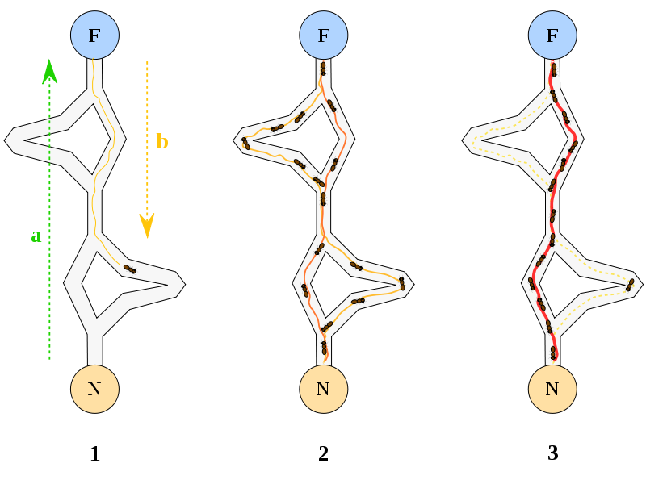
Introduction
What is ant colony optimisation?
Probabilistic approach to optimisation
Finding shortest path solutions
Why are we interested in ant colony behaviour?
Allows solutions to complex optimisation problems
How does it work?
Ants walk around randomly at first
Leave pheromone trail which evaporates with time
Future ants use trail as reference
Shortest path reinforced over time

Slide 4
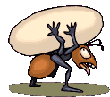
Problem statement
What do we want to achieve?
Ants can be modelled as Braitenberg vehicles
Basic decision controller
Randomly generated mazes of any size
Pheromone trail
What emergent behaviour do we want to observe?
Obstacle avoidance & navigation
Convergence using pheromone

Slide 5
Literature Review
What existing work has been done on this topic?
What can we learn from them?
What can be improved?
What is worth investigating further?

Slide 6
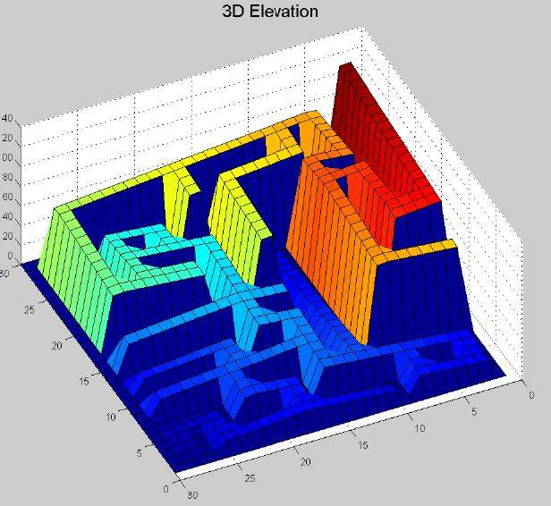
Methodology
Multi-path random maze
Potential field to food
Path planning approach
Potential field generation
Gradient descent
Division of tasks
Randomly generated maze
Potential function
Ant controller
Pheromone update
Global potential field with maze
Initialise batch of ants
Ant controller
Position update
Pheromone trail
Shortest path

Slide 7
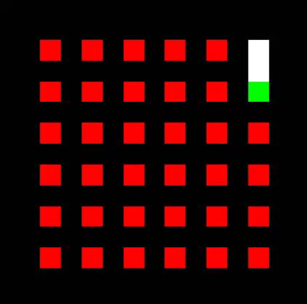
Ant MAZE GENERATION
Initialise maze dimensions
Random starting point
Recursive backtracking algorithm
Furthest end point
Multi-path maze
Remove random walls

Slide 8
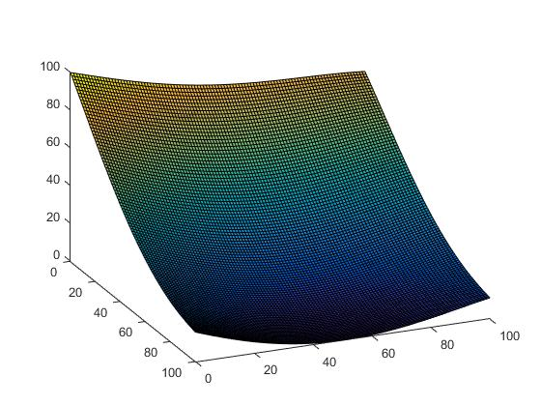
POTENTIAL FUNCTIONS
Entrance & exit from maze gen.
Add hill at entrance
Add valley at exit
Potential Field

Slide 9
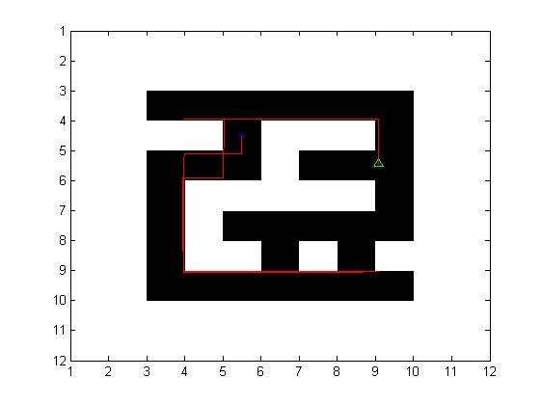
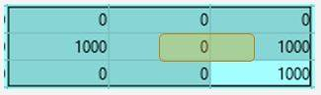
Ant Controller
Surface
Surroundings
Noise
Avoid oscillatory behaviour
Gradient decent
Proportional controller
Position update

Slide 10
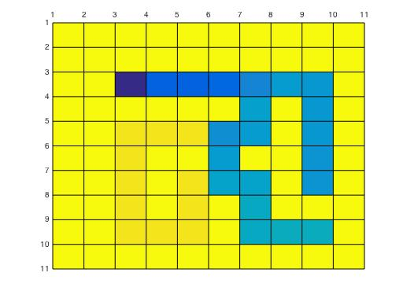
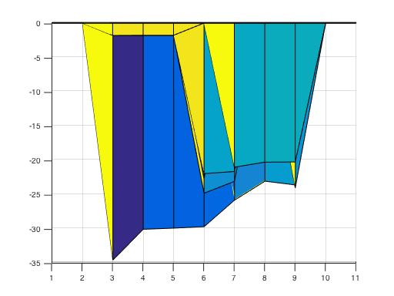
Pheromone trails
Global Pheromone
Pheromone Decay
Local Batch Pheromone
Smelling Distance
Individual Ant Pheromone
Best Ant Trail

Slide 11
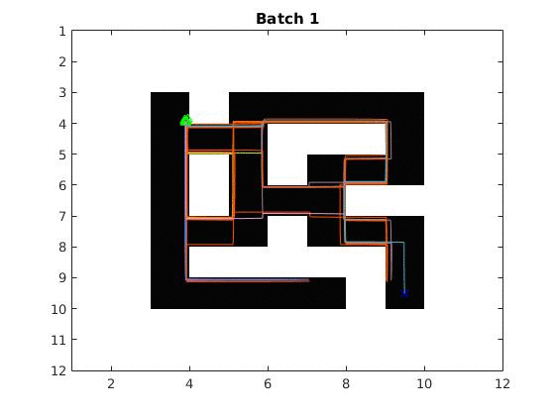
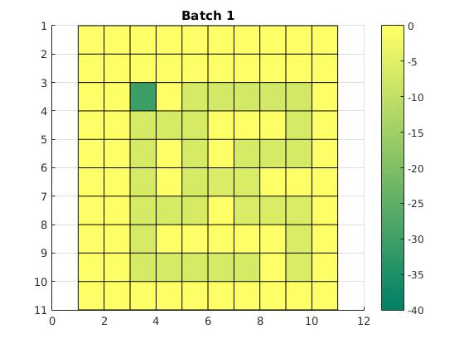
Results and discussion
Notes:
Results
Model random behaviour of ants (different paths in each batch)
Pheromone trails update successful (?)
Convergence of all ants to same path over time (?)
Convergence to shortest path (?)

Slide 12
DISCUSSIOn
What have we achieved? What were the challenges?
Successfully built a framework to investigate ant colony behaviour
Challenges: optimisation of the parameters for solution convergence to optimal path
What can we learn from this?
How can we improve this further?
Tweak noise, pheromone, potential gradient parameters
Controller

Slide 13
FUTURE WORK
Improving controller to go beyond sharp turns
Tweaking pheromone, noise and potential gradient parameters
Test with bigger mazes

Slide 14

Q & A

